Slide 1
COMS W6998 SYSTEMS FOR HUMAN DATA INTERACTION
Eugene Wu
http://columbiaviz.github.io

Slide 2
Today’s class
Essentials
What is this class?
Getting to know you
Share a human data interaction system you like

Slide 3
Covid Policy
REQUIRED: Vaccinated & Masked
No more than 15 people
in-person after today

Slide 4
Essentials.
Eugene Wu
421 Mudd (DSI space)
ewu@cs.columbia.edu (NOT preferred)
Use slack
OH: Tues 2-3PM
http://columbiaviz.github.io
Class: MW 1-2:30PM. 401 Chandler

Slide 5
Essentials.
TA: TBA

Slide 6
Essentials. Prereqs
Useful:
4111 Intro to databases
Declarative languages and data independence
Relational algebra, SQL, relational model
Query optimization and execution
See Ramakrishnan, Gehrke for basics
4996 Intro to data vis
4170 User interface design
Great to have people with different backgrounds
Talk to me if unsure
If graduate student from different area, talk to me

Slide 7
Essentials. Waitlist
First reviews due Tues midnight
A1 due Sun midnight
Participate in class
Enrollment decided based on submissions’ quality and participation

Slide 8
What is this class?
Initially a research reading group, but opened it up
Take what you want
Will not be taught (e.g., not a traditional lecture-based class)
Will not be tested (no exams, minor assignments)
You will conduct research
Read, comment on, discuss research papers and ideas
Do research project
It is hard!
Requires consistent work, ingenuity, and trial&error
If you haven’t done research at all before, talk to me

Slide 9
Overview.
Study a research area: Systems for Human Data Interaction
Related to: HCI, Vis, Databases
Important in modern data-driven world/data-science
97% of world not programmers
100% of world revolves around data
Not just interface design, not just systems
How?
Critically read and evaluate papers
Discuss and/or present research
Conduct novel, publishable research

Slide 10
Overview. Related Work
creative and systematic work undertaken
to increase the stock of knowledge
– OECD
Any idea or paper is always related to its related work
Reading research: understand the context and alternatives
Doing research: understand what exists to know what’s new
Notes:
Organisation for Economic Co-operation and Development

Slide 11
Overview. Grading
Project 50%
Proposal 5%
Draft 5%
Demo/Poster 5%
Paper 35%
Participation 20%
Paper reviews 20%
Assignments 15%
No curve, everyone can get A
If project is amazing, automatic A

Slide 12
Overview. Class Format
Submit reviews ahead of time
General discussion (5 min)
Breakout discussions (15-20 min)
Context and deep dive into paper (50 min)
Open ended discussion/debug (10 min)
What is great about the work?
What could be better
Everyone reads, prepares observations & Qs
Scribes assigned to take notes
Signup to lead presentations. Scribes will be assigned

Slide 13
Overview. Reviews 20%
Submit midnight before class
Shared on class Wiki
Can skip 3 reviews
Late submissions not accepted
Prompts and review styles will change throughout semester.
Generally ask you to contextualize the ideas and apply them

Slide 14
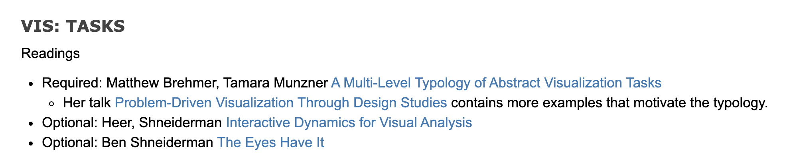
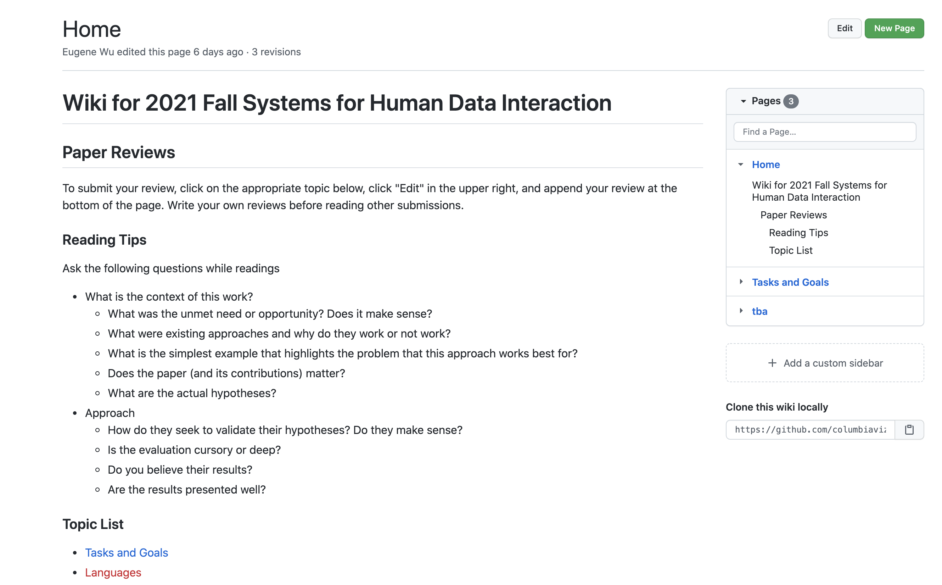
Overview. Reviews 20%

Slide 15
Overview. Presentation 5% EC
20 minutes
Cover key elements of paper
Find & read related work to provide context
Intuition >> formulae
Create your own examples, don't download the authors' slides
By A1 deadline, choose what papers you want to present and when
Choose from reading list in the schedule, or others

Slide 16
Overview. Participation 20%
Deep dive: dissect a section of text
Go sentence by sentence
Understand why it was written in a particular way
Discussion: open-ended debate of paper
What could authors have done better?
What did authors do well?
What are related ideas? How could it be extended?
Be prepared with questions and thoughts

Slide 17
Overview. Assignments 15%
Goal: try using the systems described in the papers yourself
Not meant to be burdensome.
~4 assignments throughout the semester
Assessment based on honest effort

Slide 18
Overview. Research Project 50%
Teams of 1-2.
Work proportional to team size
Build/design/evaluate something new and cool
Project that is ~publishable in an HDI conference/workshop
Go Big!
Timeline
Proposal 10/6 4 weeks (5%)
Check-in 10/13 1 weeks (0%, mandatory)
Paper Draft 11/05 3 weeks (5%)
Showcase 12/6 4 weeks (5%)
Final Paper 12/13 1 week (35%)

Slide 19
Overview. Research Project 50%
The most important aspect of research: clear hypothesis
Is it worth asking? Based on existing work, user needs
Can be answered? Based on specificity and scope
Has it been answered correctly? Based on methodology

Slide 20
Overview. Research Project 50%
BAD
“We want to build X with features A, B, C”
Ignores why it’s worthwhile and new
Confuses artifact as the goal
GOOD
“Evidence shows that Y is important, but existing work have a gap in X. We show that to fill the gap, A, B, and C and needed”
Grounded in related work and user needs
Explains why A, B, and C are necessary

Slide 21
Overview. Research Project 50%
If project is a perceptual/user study
Focus is on the task that the study will better illuminate
Show: new understanding of users
If project is a system/tool/interaction design
Focus is on the task that is improved
Show: novelty, performance, ease of use
If project is an algorithm
Focus is an existing or new task
Show: novel, correctness, scalability

Slide 22
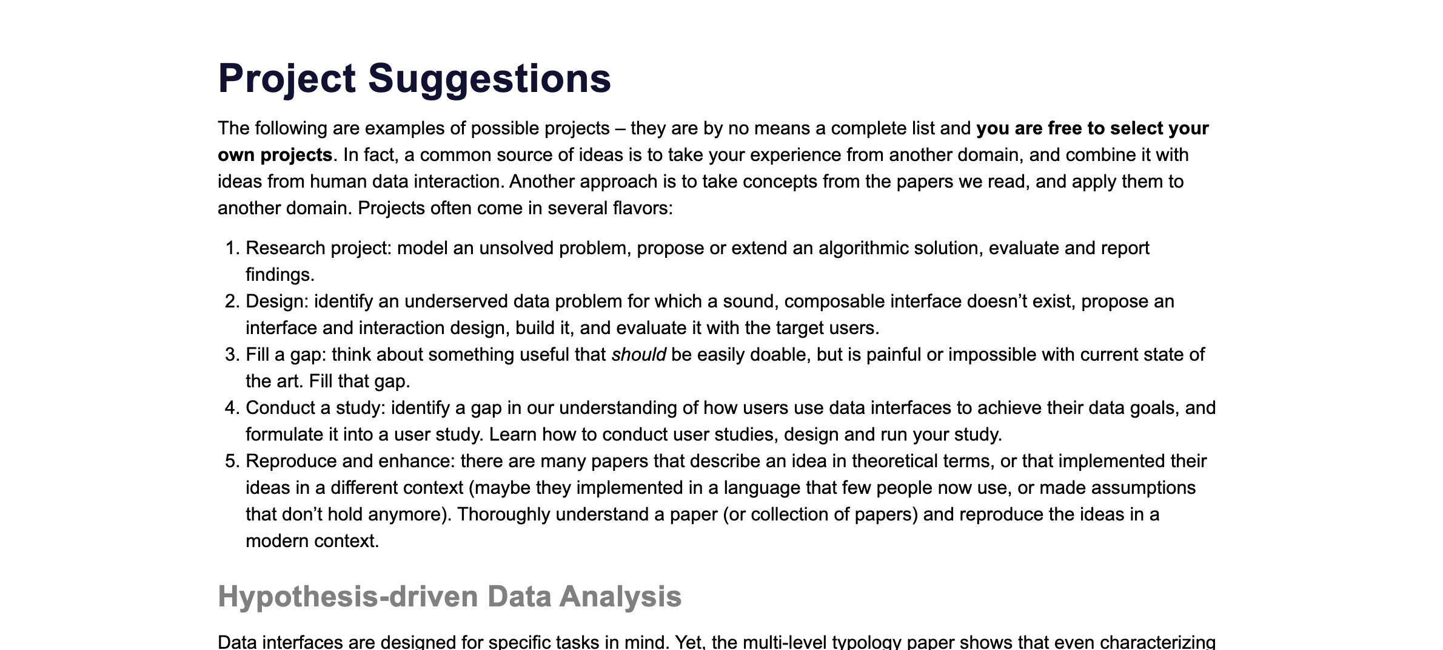
Overview. Research Project 50%

Slide 23
Overview. Research Project 50%
Many possible example projects
A tool to automatically detect data errors or violations
A scatter-plot tool that scales to 10M datapoints
A tool to find and use useful data sets from thousands or millions of data sources (tables, excel, csvs, etc)
A tool to rapidly iterate between visualization and models
A new algorithm to to synthesize analysis programs from a domain-specific DSL
Extending an existing algorithm to handle a new setting or domain
<insert your idea, highly encouraged!>

Slide 24
Questions?

Slide 25
Getting to know you
Introduce yourself
A recent dish that you enjoyed eating
Which department/program are you in?
What aspect of this course are you interested in?

Slide 26
Introduction to the course topics

Slide 27
Data Interfaces

Slide 28
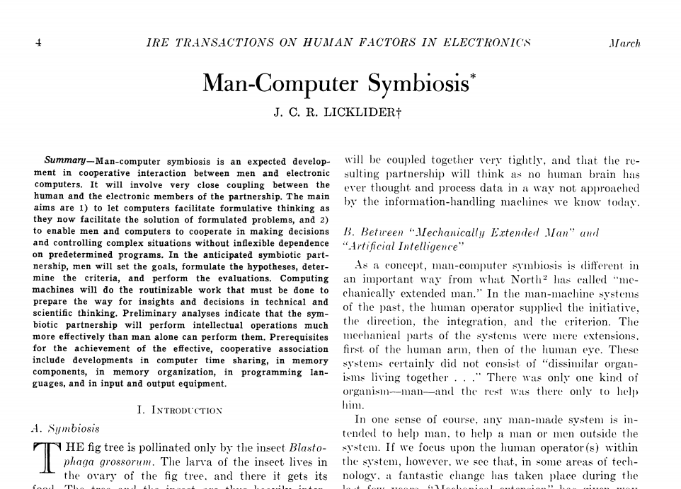

Slide 29
Static Visualization

Slide 30
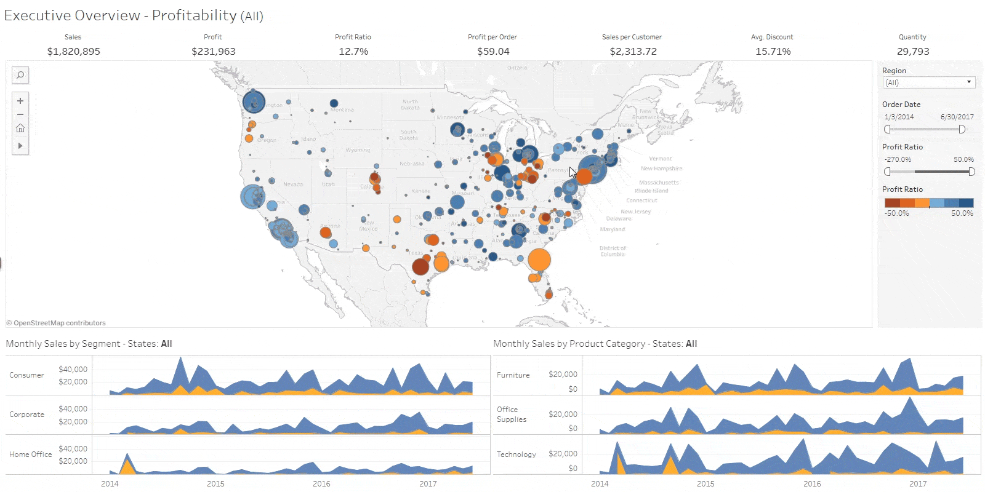
Classic BI
Tableau ($16B)

Slide 31
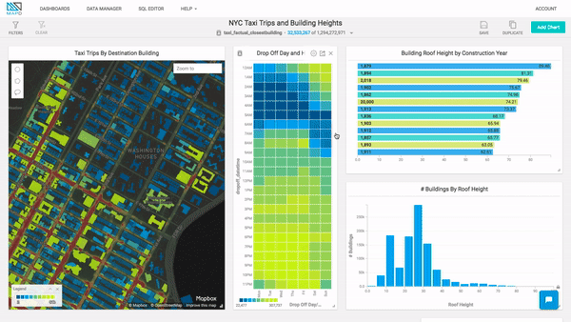
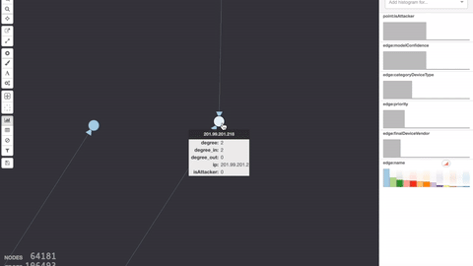
Omnisci
Graphistry

Slide 32
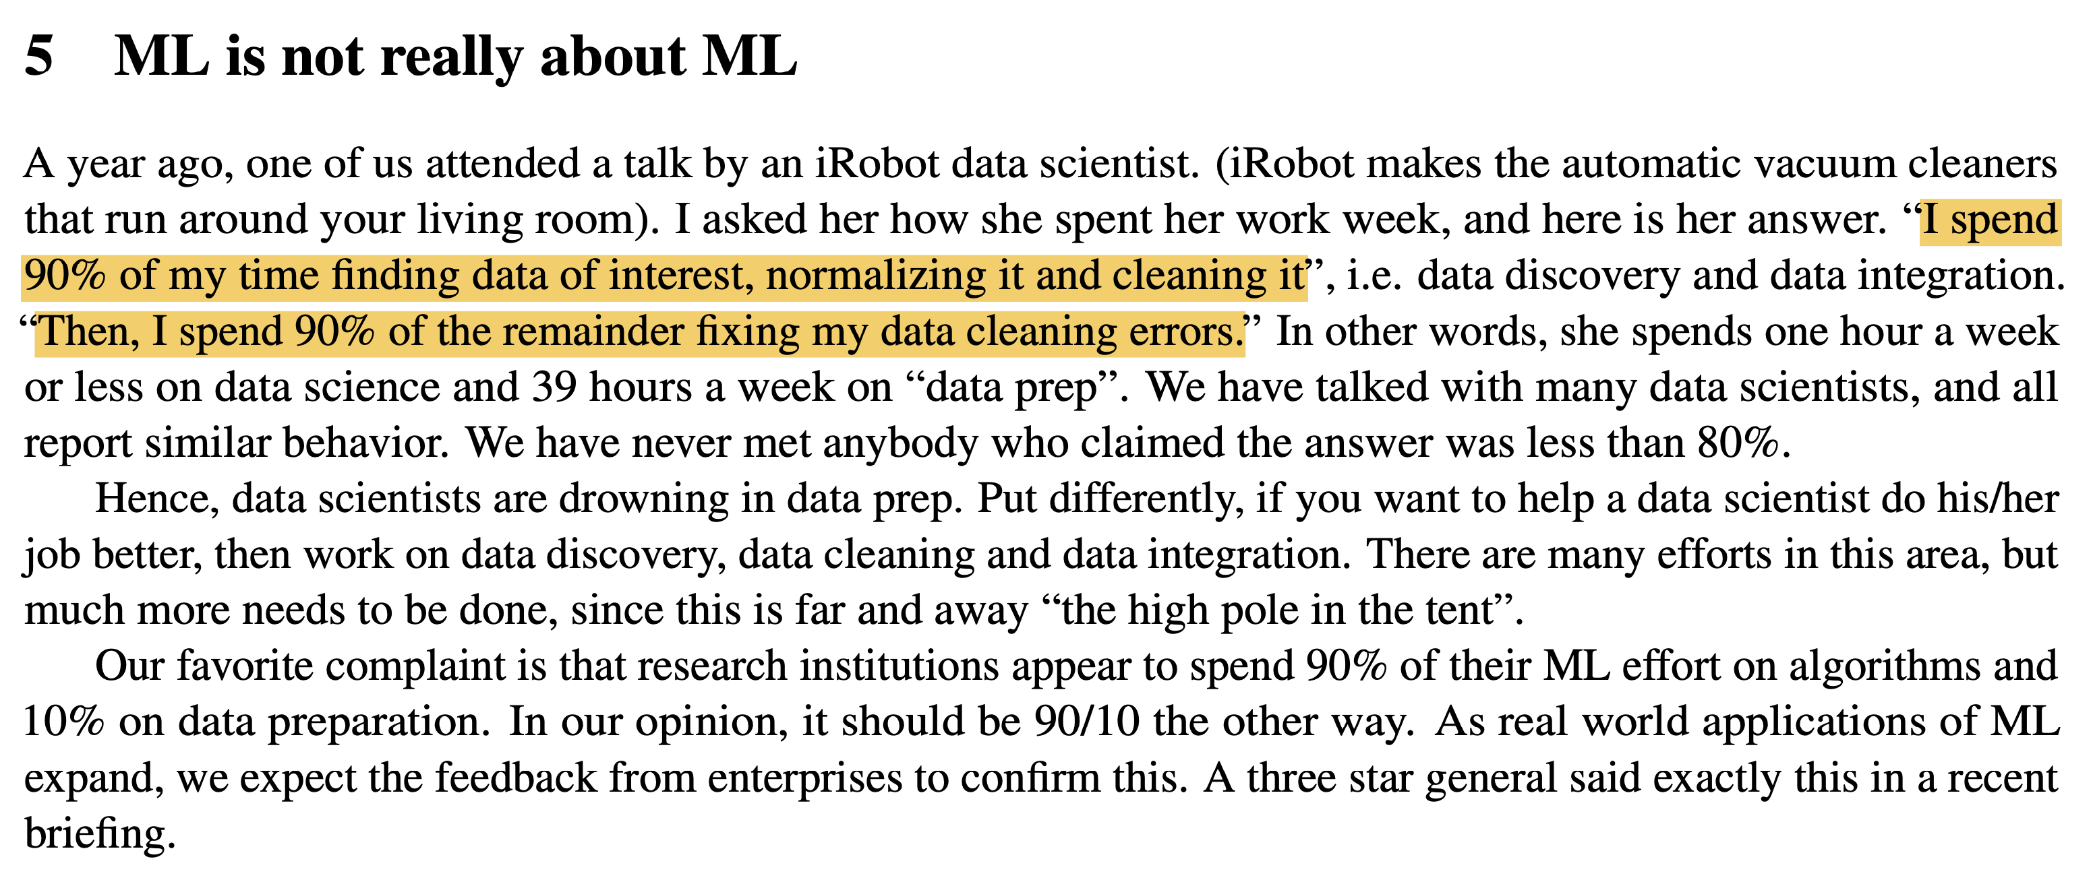

Slide 33
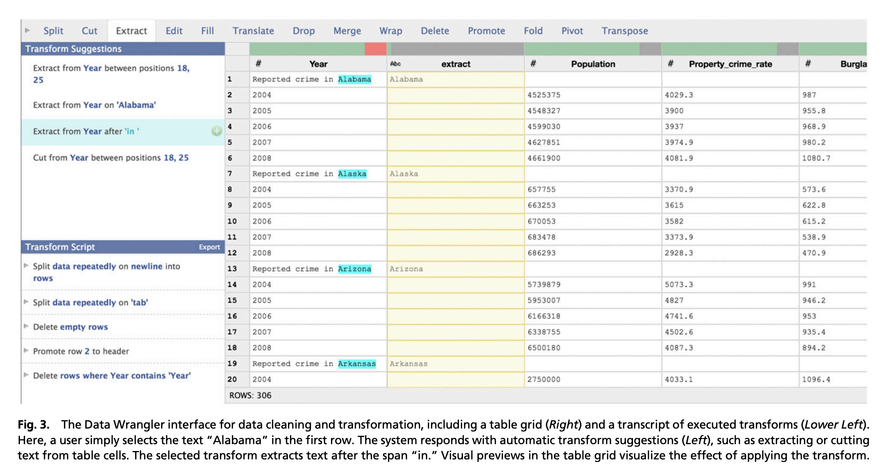
Wrangling

Slide 34
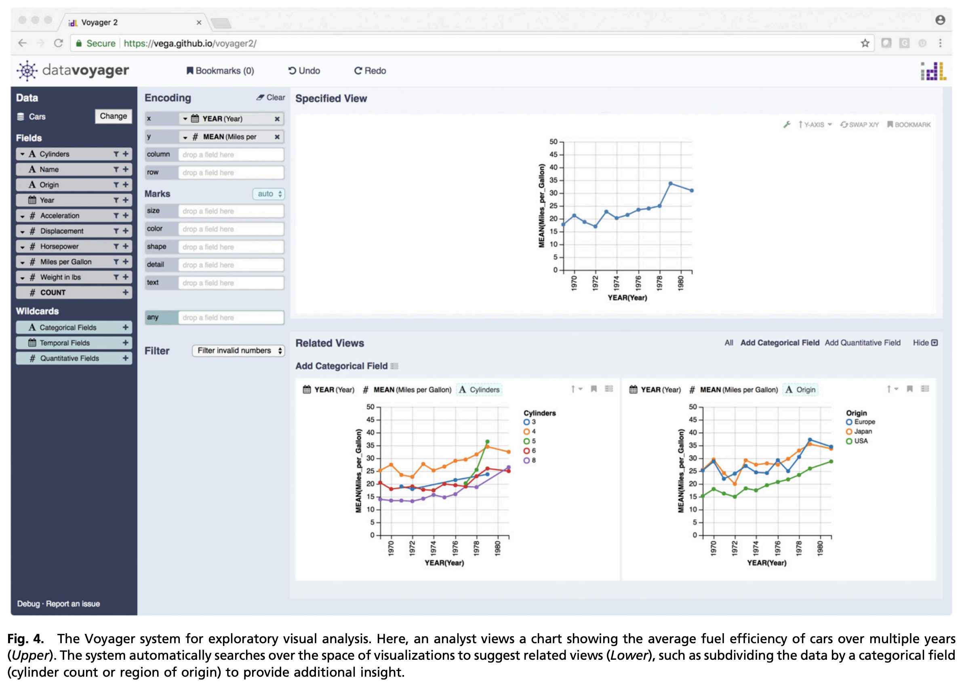
Exploration

Slide 35
Modalities: gesture

Slide 36
Modalities: example-based

Slide 38
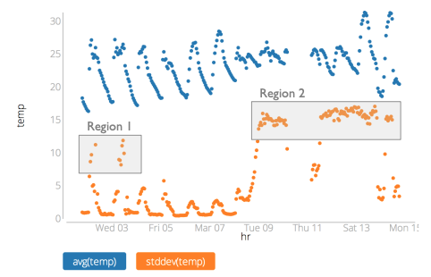

Slide 39
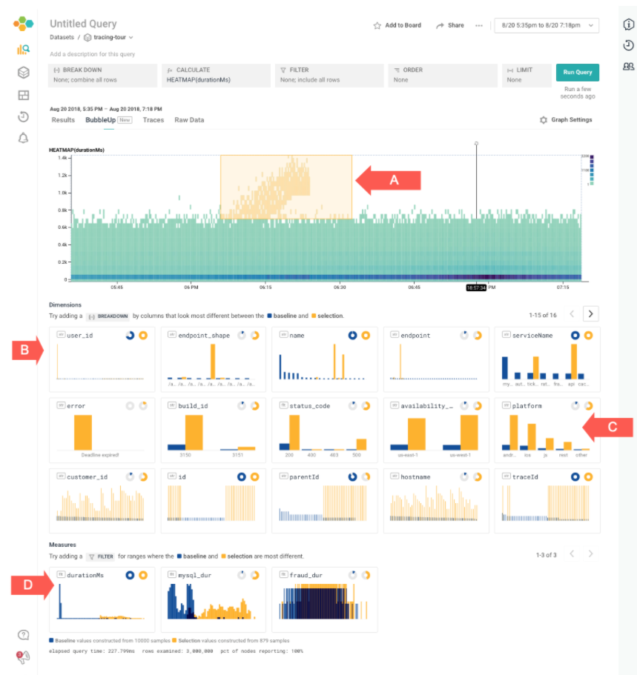
https://docs.honeycomb.io/working-with-your-data/bubbleup/

Slide 40
The need for Systems

Slide 41
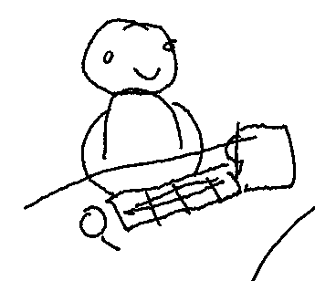

Human Computer Interfaces
Notes:
One of the most powerful aspects of technology is that it can empower people to build and create for them selves.
Interfaces help do this

Slide 42
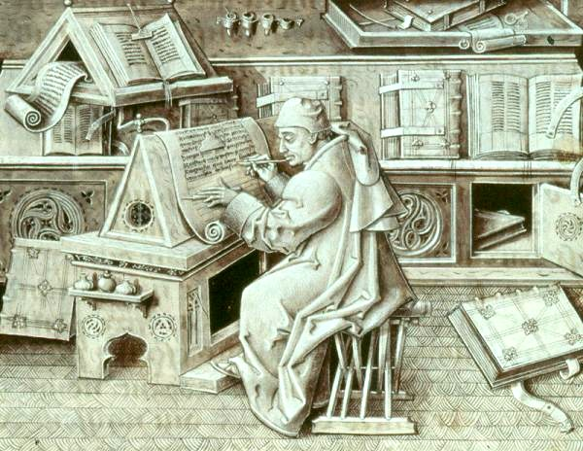
Notes:
For millenia since ancient Egypt, scribes were used to write and copy manuscripts

Slide 43
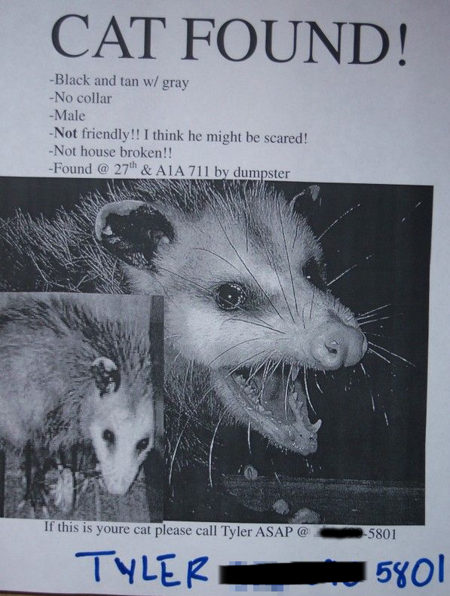
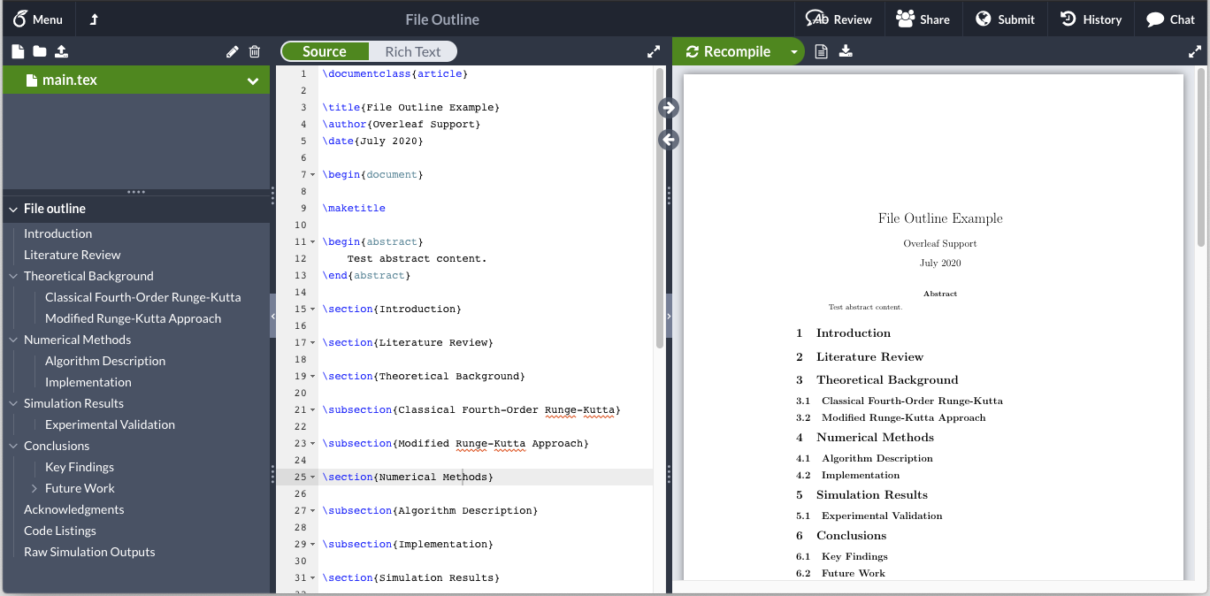
Notes:
Today, word processors enable anyone to open up a webpage, write research papers, novels, memos, and even local neighborhood announcements

Slide 44

Design
Development
Deployment
Notes:
But what’s more powerful are tools to CREATE new interfaces
Over the past decade, the tools for creatin new interactive applications and interfaces has evolved to the point where it’s possible for a non-programmer to create and deploy a rich, interactive, scalable application without writing much code at all.
This is thanks to

Slide 45
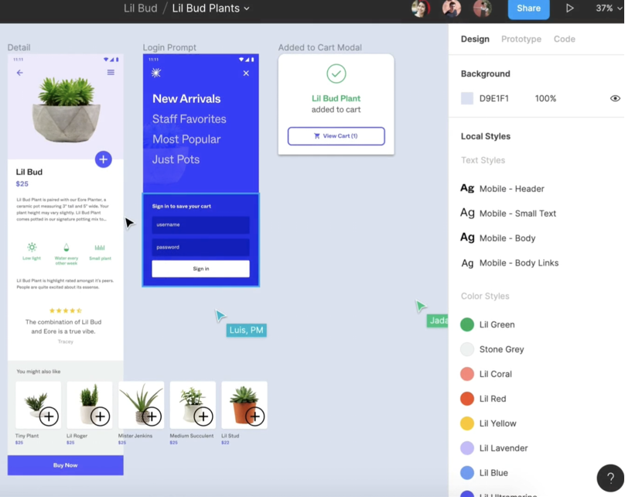



Design
Development
Deployment
Notes:
Design tools like figma, plasmic, and webflow, that are like Microsoft word, but for interface design.

Slide 46
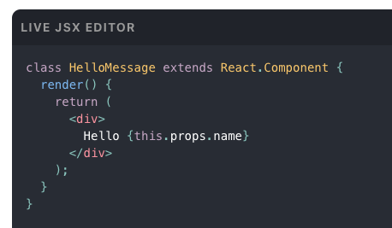




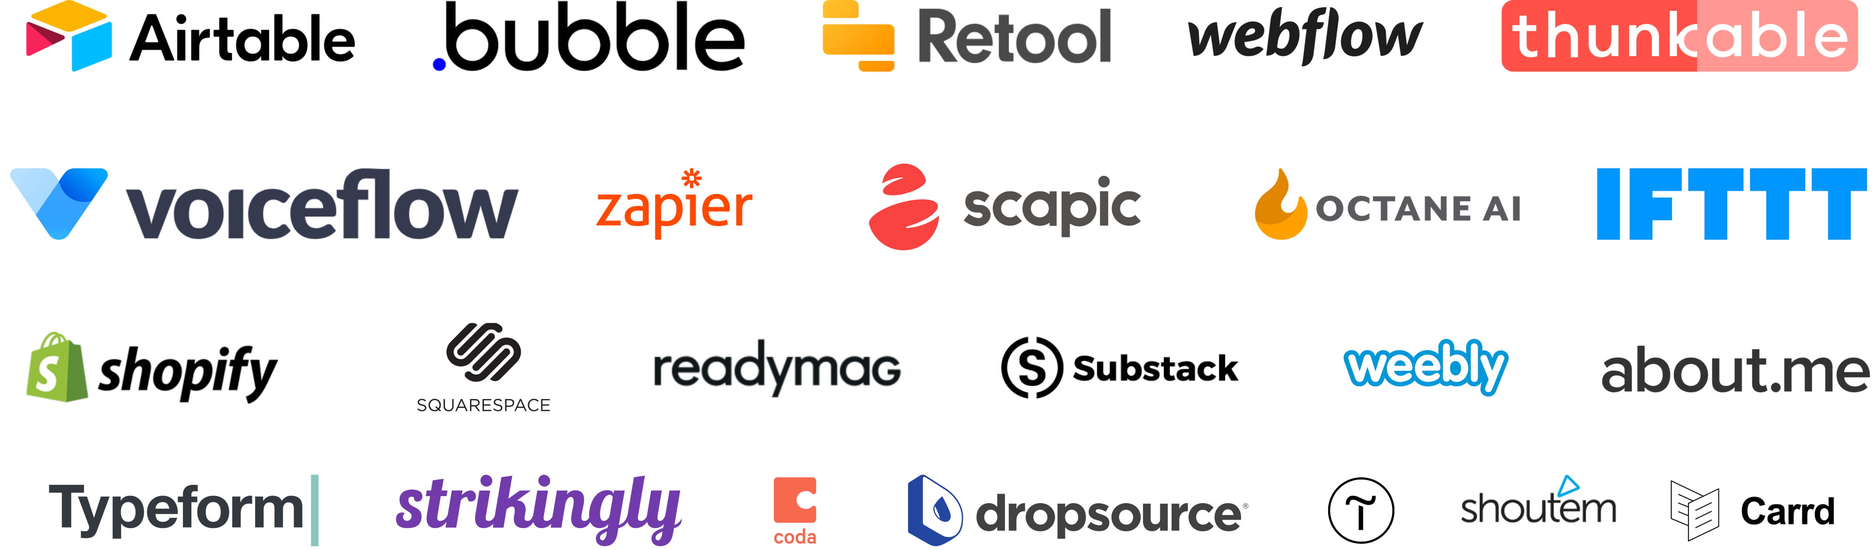
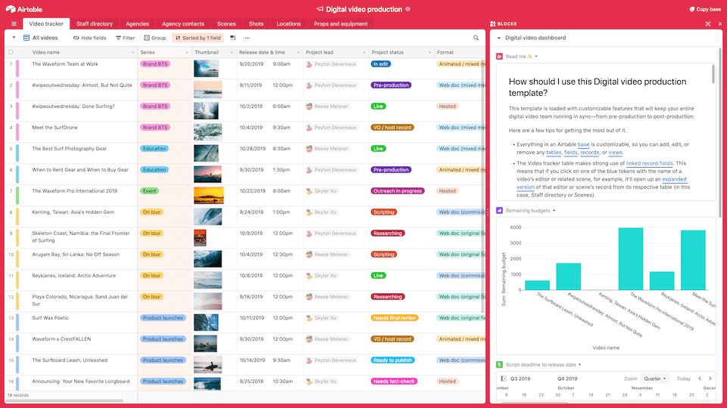
Design
Development
Deployment
Notes:
Development tools that dramatically simplify going from design to code.
These range from libraries like react and svelt, as well as low code and no code tools like Airtable and bubble.

Slide 47
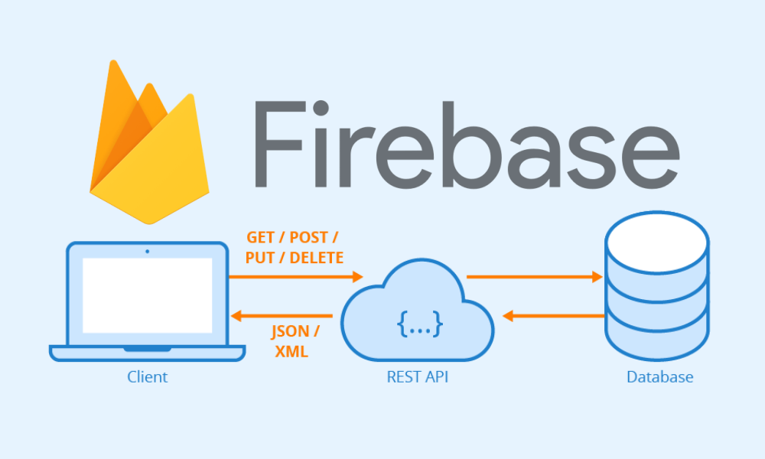




Design
Development
Deployment
Notes:
And finally deployment is one click and free, thanks to cloud databases, storage, and compute that are essentially free.

Slide 48
Human Data Interfaces
Data
Notes:
The center of gravity has shifted towards data, yet, this type of tooling ecosystem doesn’t exist for building human data interfaces.
Sure we have large scale databases, and data science platforms like Jupyter, but the design tools, no and low code environments, and one-click deployment simply does not exist.

Slide 49
10 rows
10 rows
Traditional Interface
Data Interface
Data
Notes:
The center of gravity has shifted towards data, yet, this type of tooling ecosystem doesn’t exist for building human data interfaces.
Sure we have large scale databases, and data science platforms like Jupyter, but the design tools, no and low code environments, and one-click deployment simply does not exist.

Slide 50
10 rows
1M rows
Traditional Interface
Data Interface
Data
Notes:
The center of gravity has shifted towards data, yet, this type of tooling ecosystem doesn’t exist for building human data interfaces.
Sure we have large scale databases, and data science platforms like Jupyter, but the design tools, no and low code environments, and one-click deployment simply does not exist.

Slide 51
10 rows
∞ rows
Traditional Interface
Data Interface
Data
Notes:
The data that the data interface directly aggregates over is essentially unbounded

Slide 52
Challenges
Scale
Human Data Interfaces
Data
Notes:
The first is scale.
The argument in this talk is that filling this gap is largely a data management problem.
It’s not a problem “for HCI or VIS folks” to figure out, and it’s not about running SQL faster.
It’s our opportunity to define HOW should users interact
What data tasks should look like, how they can be expressed,
And really to build those systems.
Look at just the problem of running vis queries faster – motivated tons of aqp, progressive querying, etc papers

Slide 53
Challenges
Scale
Design dependence
Interfaces
Systems
Data
Notes:
And the second is from the fact that the design of the interface and of the system architecture are deeply coupled.

Slide 54
Challenges
Scale
Design dependence
Interfaces
Systems
Data
Notes:
I want to start with examples of each of these challenges.

Slide 55
Small Data
Browser
Notes:
If your dataset is small and is fast to process in the client, then the problem is arguably solved and there’s many great solutions.
But as the data size grows, your architecture becomes more complex

Slide 56
Medium Data
Browser
Laptop
Notes:
You may need to shift processing out of the browser to your laptop

Slide 57
Large Data
Browser
Laptop
network
Server
Database
Notes:
Or to a dedicated server and database

Slide 58
XL Data
DB query latency
Network bottlenecks
Distributed system
Cloud API calls
Browser
Laptop
network
Server
Database
Notes:
And even the cloud.
All of this introduces latency at every system boundary, network bottlenecks, cloud API calls, and the fact that you are running a distributed system,

Slide 59
XL Data
Low Latency
DB query latency
Network bottlenecks
Distributed system
Cloud API calls
Browser
Laptop
network
Server
Database
Notes:
The interface has not changed, so the user still expects the same responsiveness

Slide 60
XL Data
Low Latency
DB query latency
Network bottlenecks
Distributed system
Cloud API calls
Caches to hide latencies
Browser
Cache
Laptop
Cache
network
Server
Cache
Database
Notes:
So you would add caching to hide latencies

Slide 61
XL Data
Low Latency
DB query latency
Network bottlenecks
Distributed system
Cloud API calls
Caches to hide latencies
“Smart” caches (DBs)
Browser
DB
Laptop
DB
network
Server
DB
Database
Notes:
If you want to process data in the caches, then they start to look like databases

Slide 62
















Low Latency
Browser
DB
Laptop
DB
network
Server
DB
Database
Notes:
Of course there’s great libraries and systems for every individual problem,
But optimizing and combining them together is nontrivial.
If you squint this is

Slide 63
Low Latency
HDI Memory Hierarchy
Browser
Laptop
network
Server
Database
Notes:
akin to the memory hierarchy, and programming against the memory hierarchy is a fundamental challenge in CS
However in this case, we are asking the designers to

Slide 64
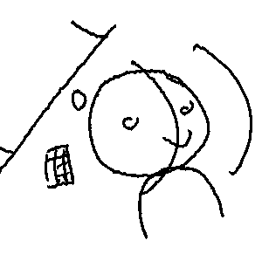
HDI Memory Hierarchy
Browser
Designers manually
program & optimize
against memory hierarchy
Lack of good abstractions
Laptop
network
Server
Database
64
Notes:
Manually program & optimize against this hierarchy by combining disparate software systems,
This signals a lack of good abstractions

Slide 65
Challenges
Scale
Design dependence
Interfaces
Systems
Data

Slide 66
Challenges
Scale
Design dependence
Interfaces
Systems
Data

Slide 67
Browser
count
name
Server
votes(name, date,
vote, chamber)
Notes:
Let’s look at a simple example.
The left is an interface to help analyze legislative votes from cambes of congress
And the right is the client-server architecture and different precomputation optimization choices

Slide 68
Browser
Date
1990s
2000s
count
name
Server
votes(name, date,
vote, chamber)
Notes:
If we add two buttons to choose the decade

Slide 69
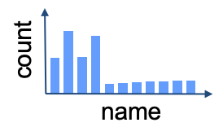
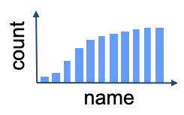
Browser
Date
2000
1990s
2000s
count
name
Server
Precompute
1990:
2000:
votes(name, date,
vote, chamber)
Notes:
The server could precompute both decades, and send the precomputed results in response to each button

Slide 70
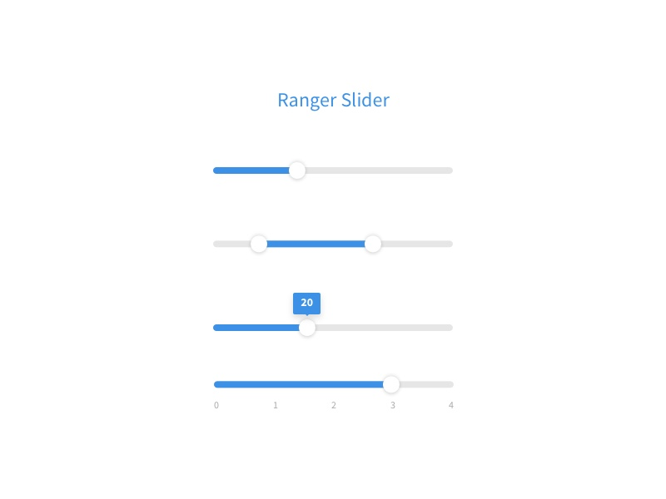
Browser
Date
Data cube
count
name
Server
Precompute
Data Cube(Date)
votes(name, date,
vote, chamber)
Notes:
But changing the buttons to a range slider requires precomputing a quadratic number of views,
So a different data structure like a cube is needed.
Maybe you even cache and process the cube on the browser

Slide 71
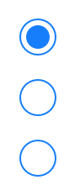
Interface Design
is coupled with
System Design
Browser
Date
count
Chambers
name
House
Senate
Server
All
Precompute
Chambers→Cube(Date)
votes(name, date,
vote, chamber)
Notes:
Adding a radio button to select the chamber requires yet another different optimization.
And this is just for this simple architecture and interface.
The bottom line is that any minor change in the interface design directly affects what optimizations are needed

Slide 72
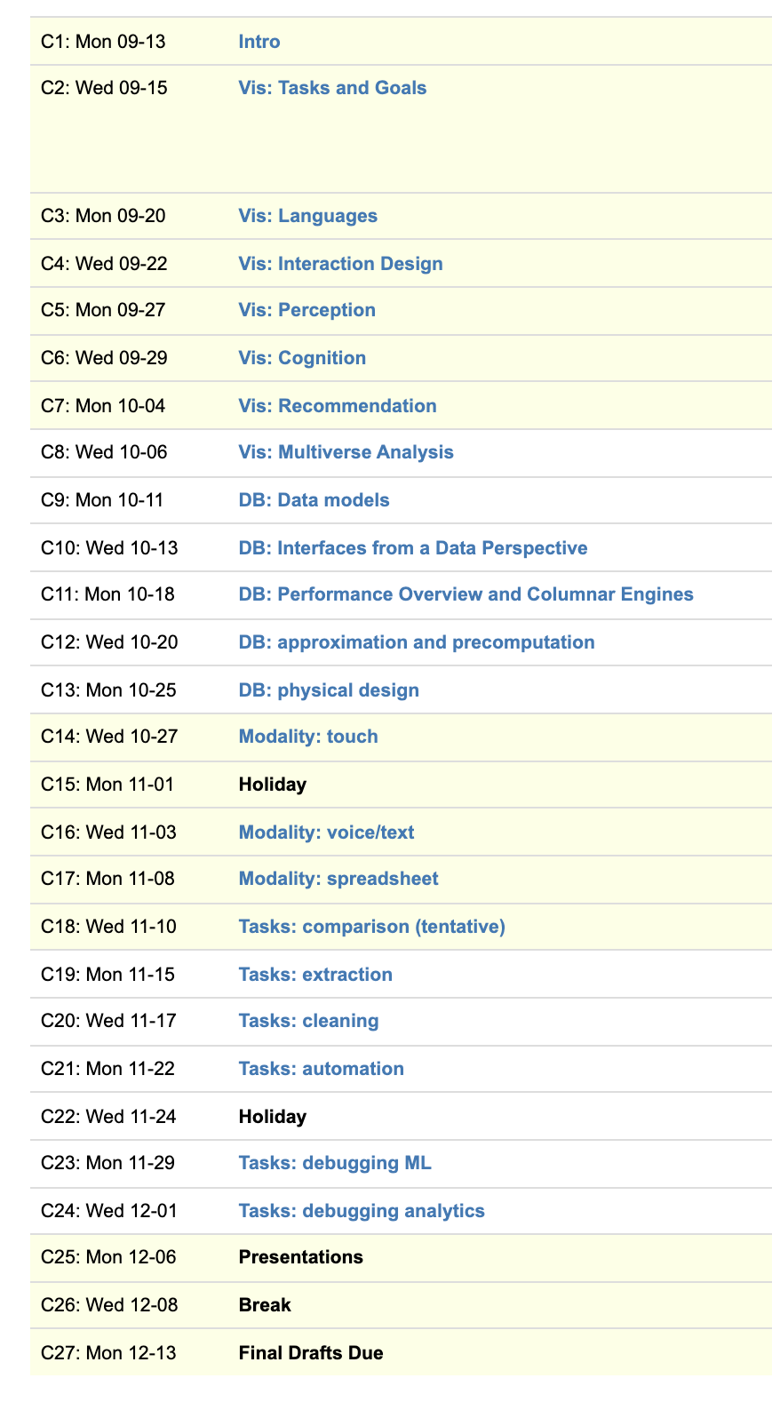
Vis
Systems
Interfaces
I/O
Systems
Tasks
Data

Slide 73
Stepping Back
CS is engineering discipline
Powered by needs
Combining areas and ideas

Slide 74
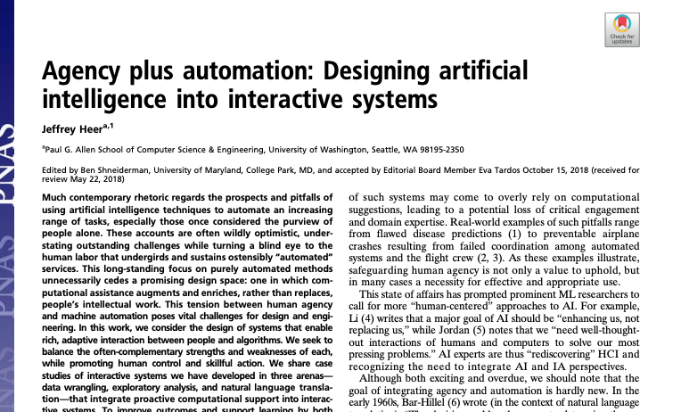

Slide 75
Your TODOs
Reviews
Assignment 1
columbiaviz.github.io is your friend

